Slide 1

DenseNet & CTC
RNN-free architecture for text recognition
GMO – 08/07/2020
Thanh Chu

Slide 2
Overview
Introduction
Dense Networks
Architecture
Connectionist Temporal Classification
Q & A

Slide 3
Introduction

Slide 4
Introduction
Dense Networks or DenseNets
One of the best performances on CIFAR-10, CIFAR-100, SVHN and ImageNet with less computation
By Gao Huang et. al. ‘Densely Connected Convolutional Networks’ 2017

Slide 5
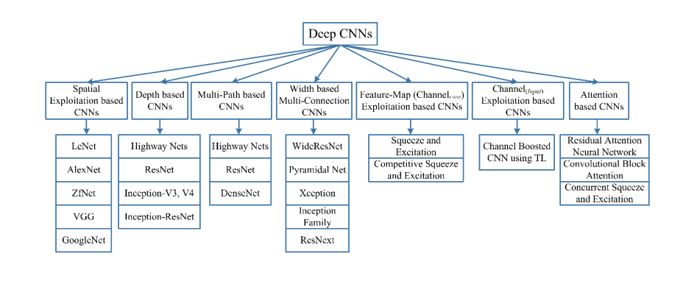
History of CNN architectures

Slide 6
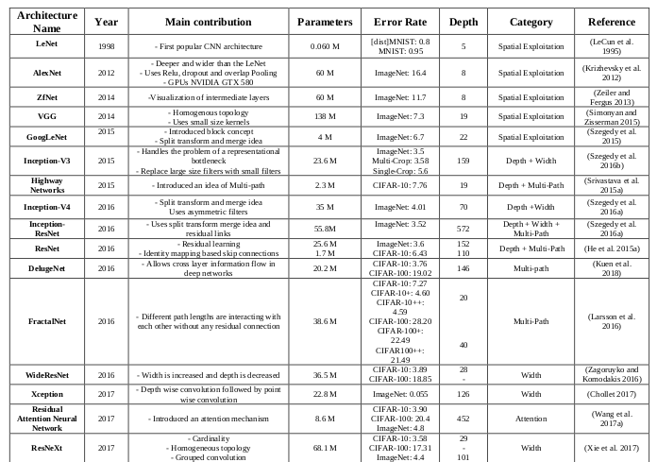

Slide 7
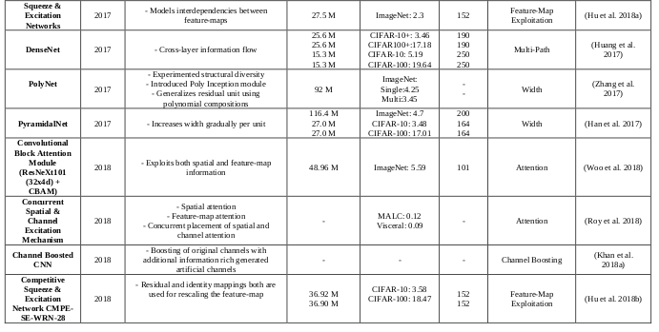

Slide 8
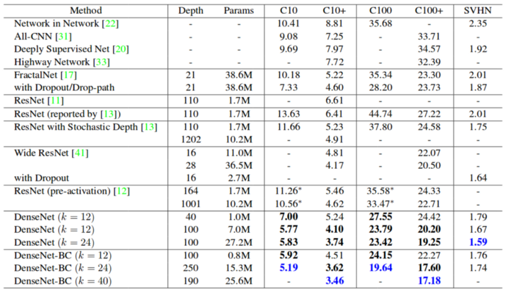
Comparison with ResNet
DenseNet-BC (Bottle-Neck)

Slide 9
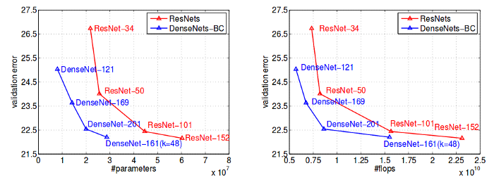
Comparison with ResNet
Same accuracy – less parameters/flops

Slide 10
Dense Networks

Slide 11
Basics
Convolution, BatchNorm, ReLU, MaxPooling
Dense + Transition
AveragePooling, Linear

Slide 12
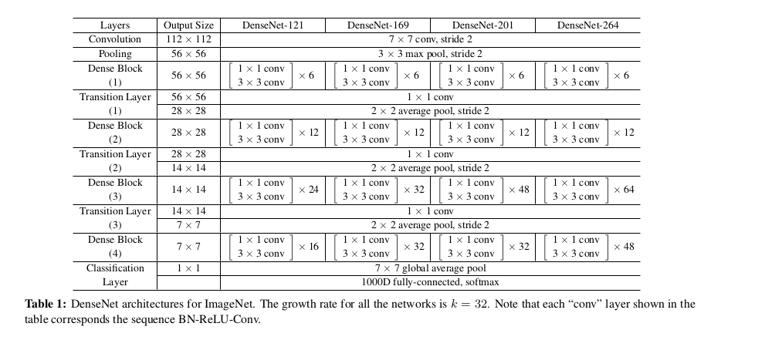

Slide 13
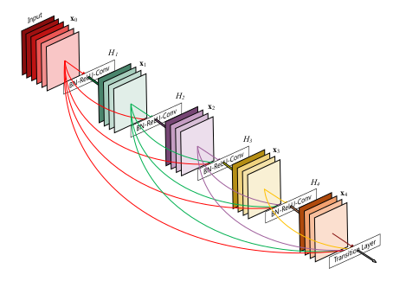
Dense Block
Dense block with 5 layers
Growth rate k = 4

Slide 14
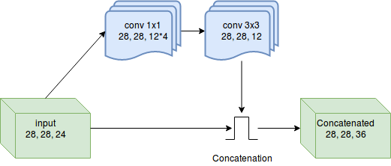
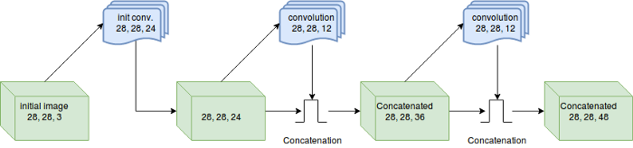
Basics
Initial features = 24
Growth rate k = 12

Slide 15


Blocks
Conv block: Batch Norm, ReLU, Conv2D (3x3)
Dense block: concatenate input and output of Conv block
Transition block: Batch Norm, ReLU, Conv2D, (1x1), AveragePooling (2x2, stride 2)
Theta — some reduction values, in the range (0, 1).

Slide 16
Intuition
DenseNet improves a flow of information and gradients throughout the network, which makes them easy to train
Each layer has direct access to the gradients from the loss function and the original input signal, leading to an implicit deep supervision.

Slide 17
Demo

Slide 18
Q & A

Slide 19
Fast DenseNet

Slide 20
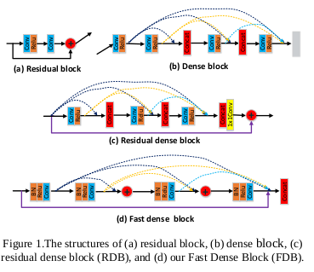
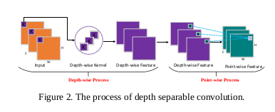

Slide 21
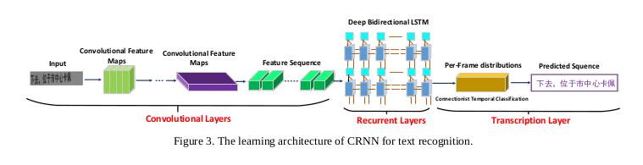
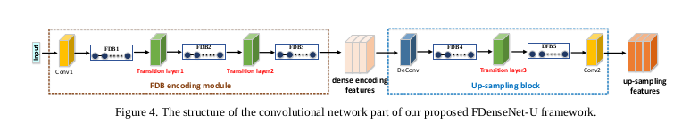

Slide 22
